Slide 1




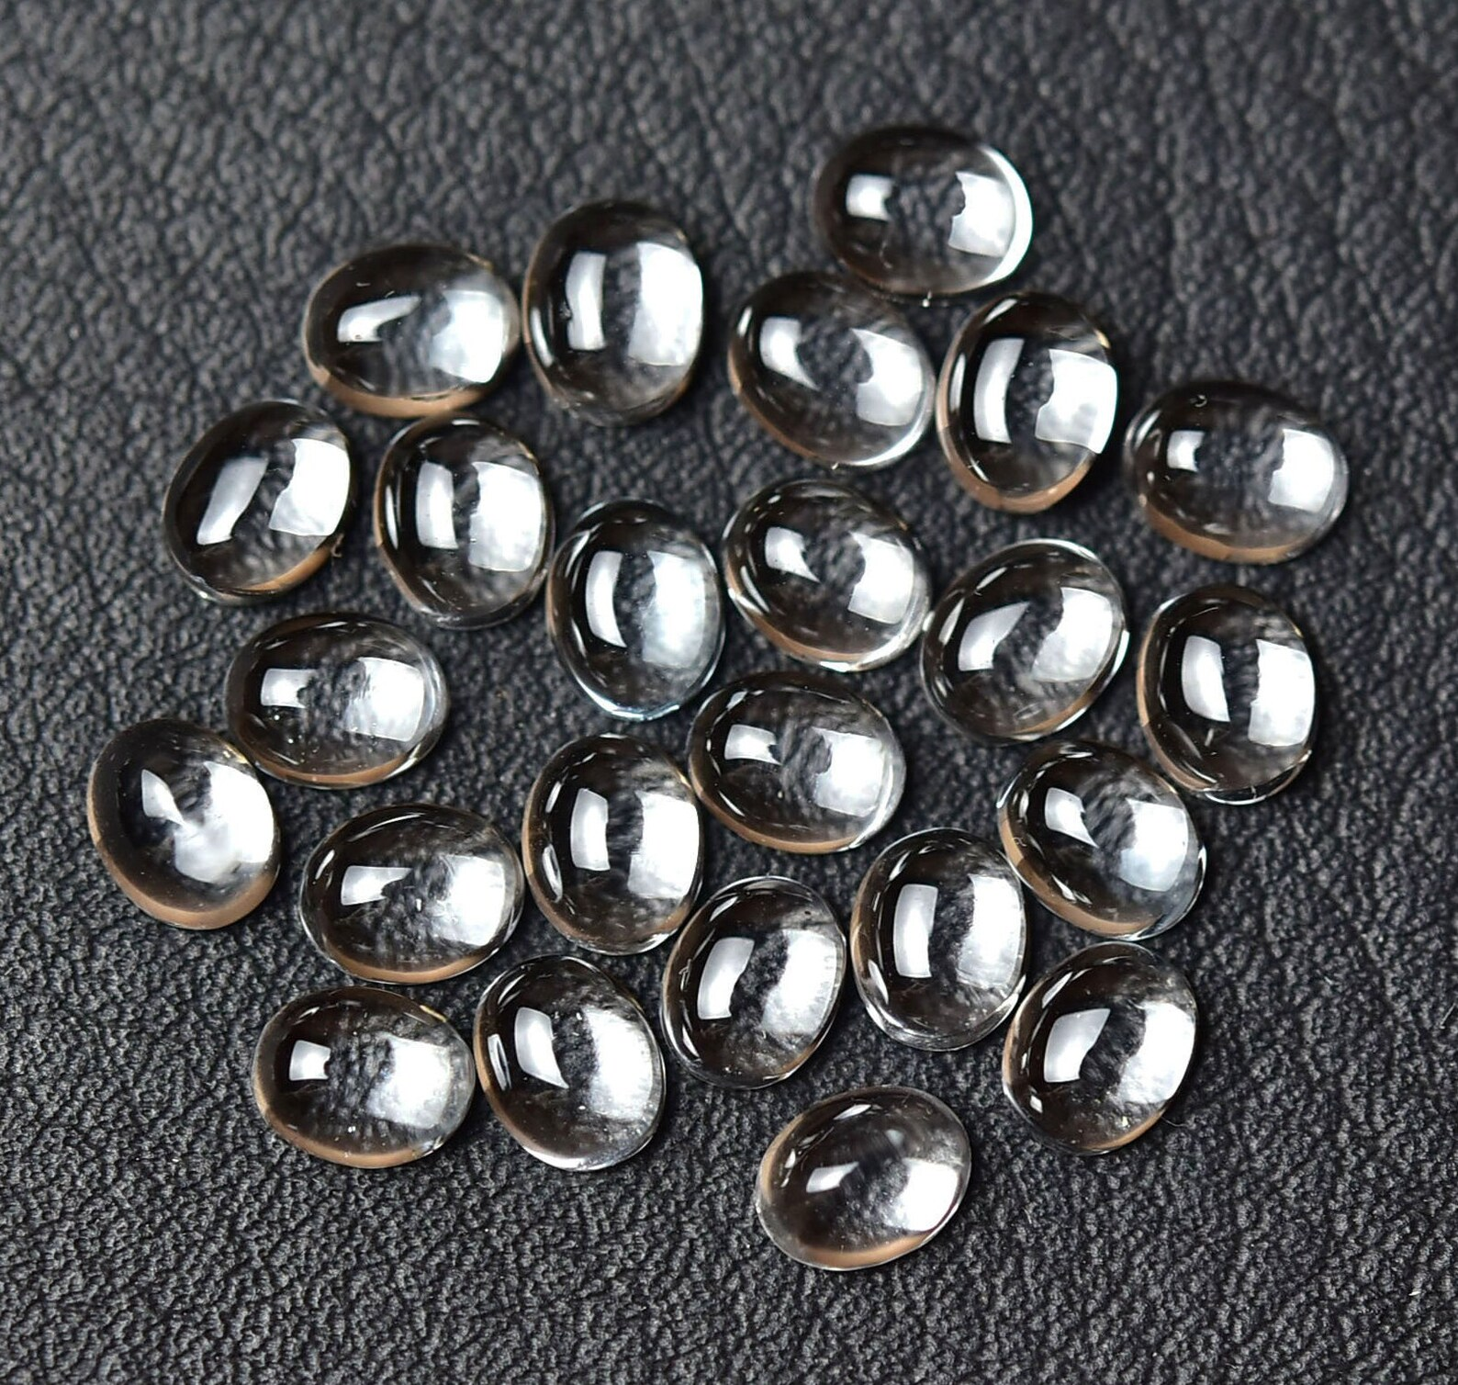
Team D.S.A.
Debang Chakraborty
Shamik Bhattacharjee
Arunava Bhattacharya

Slide 2







Problem statement
A
WHY METALLIC GLASS?
G
F
Metallic glass boasts a non-crystalline structure that exhibits exceptional properties such as strength, flexibility, and corrosion resistance.
Due to its properties, it has invaluable applications aerospace, electronics, and beyond.
Glass
Formation
Ability
OVERVIEW
WHAT IS METALLIC GLASS?
Exploring different ML models and designing the best model that predicts the Dmax (GFA) of Bulk Metallic Glasses with maximum accuracy.
Drawing important inferences from the data and validating alternate methods to predict GFA.
Metallic glasses (sometimes also referred to as glassy metals, or inappropriately as amorphous metals) are non-crystalline materials composed of either pure metals or combinations of metals and metalloids.
Problem Statement
Data Preprocessing
Data Visualization
Base Model Selection
Final Stacked Ensemble Pipeline
SHAP Valies
Inferences
Data Landscape

Slide 3
DATA landscape
GFA Features
Critical casting Diameter (Dmax)
Total electronegativity (TEN)
Average Atomic Volume (VA)
Mixing Entropy (Sm)
Onset Crystallisation Temperature (Tx)
Atomic size difference (d)
Liquidus Temperature (Tl)
Glass Transition Temperature (Tg)
Data Landscape
Data Preprocessing
Data Visualization
Base Model Selection
Final Stacked Ensemble Pipeline
SHAP Values
Inferences
Problem Statement
Notes:
2020 in circle
intensity fading away/ arrws towards it
flow chart for domain to paramters to sub-paramters

Slide 4
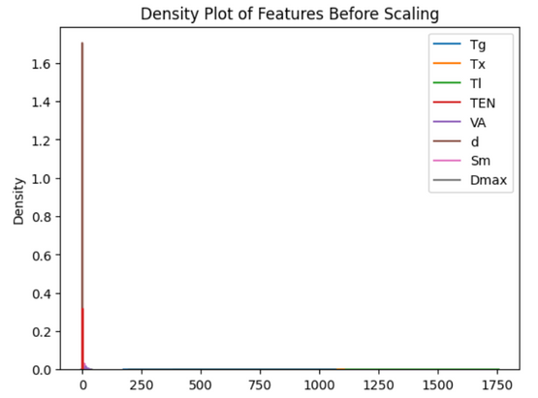

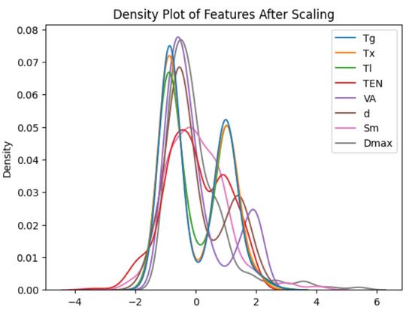
DATA preprocessing
Normalizing the data
Handling NaN values
It is important to scale the dataset as variables may have completely different scales of magnitude. Standard Scaler is used to normalize the values.
No NaN values were present in the Data set
Unscaled Data
Handling Ouliers
Replaced the outliers with NaN values
Imputed NaN values with MICE imputer
Markov Chain Integrated Equations (MICE) impute data such that original distribution is maintained without any spike in values
Scaled Data
Data Preprocessing
Data Visualization
Base Model Selection
Final Stacked Ensemble Pipeline
SHAP VAlues
Inferences
Problem Statement
Data Landscape

Slide 5
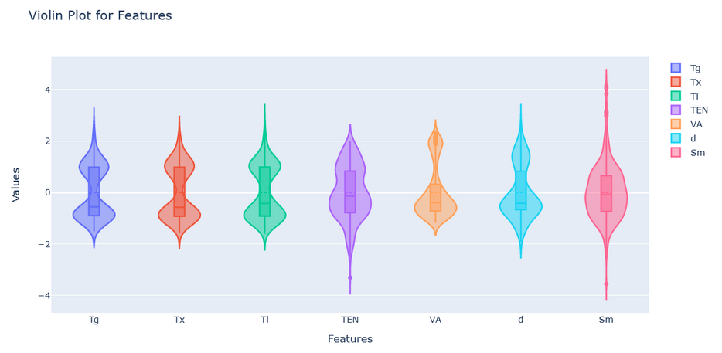
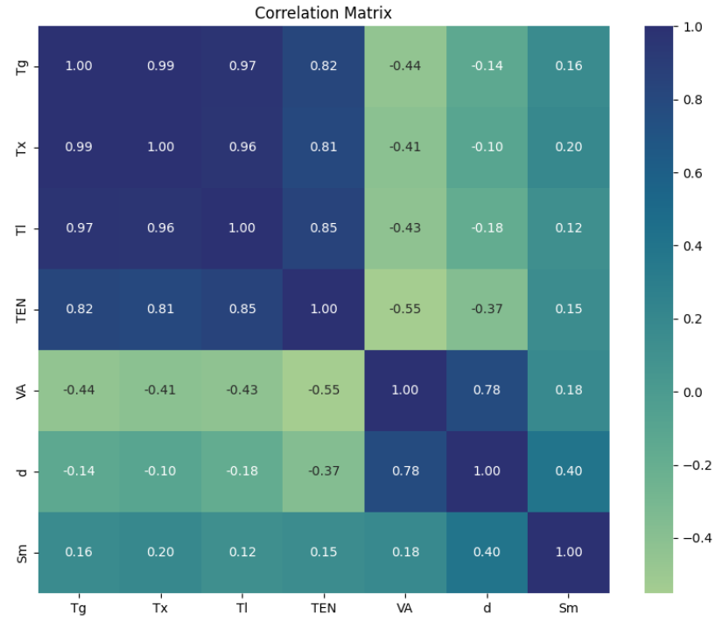
DATA VISUALIZATION
Violin Plot of Features
Correlation Plot among various features affecting the GFA
The violin plots have been plotted to get an idea about the outliers and distribution of the data. We have used the scaled data to plot the distributions for uniform subplots in all variables. We note the bimodal distributions of all the variables except Sm.
From the correlation matrix, we have observed and considered the correlation values above 0.85 to be highly correlated. Considering this, we find that the features Tx, Tl and Tg are highly correlated.
Data Preprocessing
Data
Visualisation
Base Model Selection
Final Stacked Ensemble Pipeline
SHAP Values
Problem Statement
Data Landscape
Inferences

Slide 6





Base model selection
Base model selection
1
2
3
Tg
Tx
Tl
TEN
VA
d
Sm
Curated a selection of regression models including Random Forest, AdaBoost, Extra Trees, Gradient Boosting and XGBoost
Employed Mean Squared Error (MSE) and R-squared (R2) as primary evaluation metrics.
Final Task
4
5
Compared models based on average performance and variability.
Selected the model(s) with the best average performance and lowest variability for further consideration or deployment.
Calculated average and standard deviation of evaluation metrics across multiple runs.
Implemented K-fold cross-validation to ensure robust model evaluation.
Trained and evaluated each model on training and testing sets iteratively.
Base Model Selection
Data Visualisation
Base model Selection
SHAP Values
Data Preprocessing
Data Visualisation
Approach 1
Final Stacked Ensemble Pipeline
Data Preprocessing
Data Analysis
Feature Selection
Infernces
Data Landscape
EDA
Approach 2
Results
Model Performance
Problem Statement
Data Landscape
Objective 2
Objective 3
Problem Statement
Data Landscape
Problem Statement

Slide 7
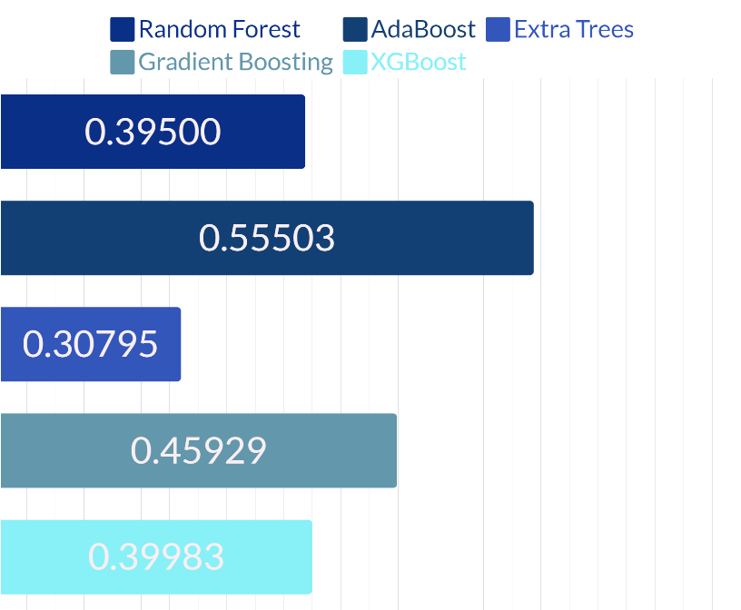
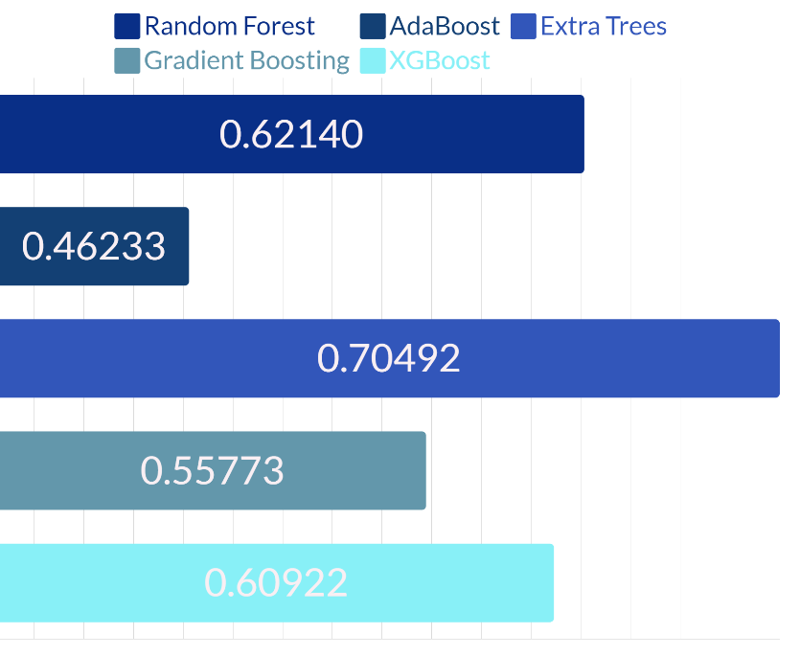
Base model selection
Average Value of Mean Squared Error (MSE)
Average R-squared Value
Data Preprocessing
Data Visualisation
Base Model Selection
Final Stacked Ensemble Pipeline
SHAP
Values
Problem Statement
Data Landscape
Inferences

Slide 8
Final Stacked Ensemble pipeline
1
2
3
Tg
Tx
Tl
TEN
VA
d
Sm
Ensured reproducibility by setting a seed for consistent results.
Utilized an Extra Trees Regressor and a Keras neural network as base models
Conducted 10-fold cross-validation with shuffling for robust evaluation.
Split training data into train and validation sets for each fold.
Final Results
4
5
R2 score = 0.822
Standard Deviation (R2-Scores)
= 0.0664 (6.64%)
Evaluated ensemble predictions using R-squared score on the test set.
Averaged R-squared scores across 10 folds to summarize performance.
Trained base models and stacked predictions for input to the meta-learner.
Trained the meta-learner (Extra Trees Regressor) on stacked predictions.
Base Model Selection
Final Stacked Ensemble Pipeline
Data Preprocessing
Data Visualisation
Approach 1
SHAP Values
Data Analysis
Feature Selection
Inferences
Data Landscape
EDA
Approach 2
Model Performance
Problem Statement
Data Landscape
Problem Statement

Slide 9
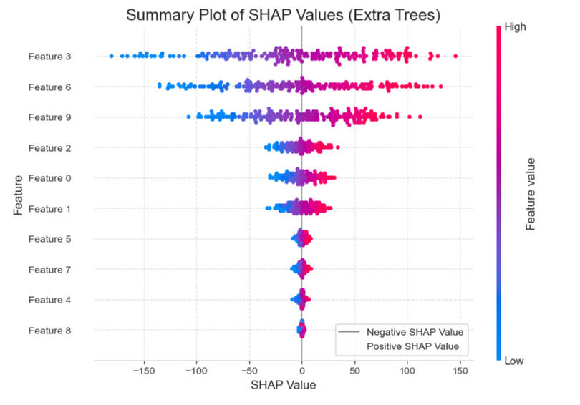
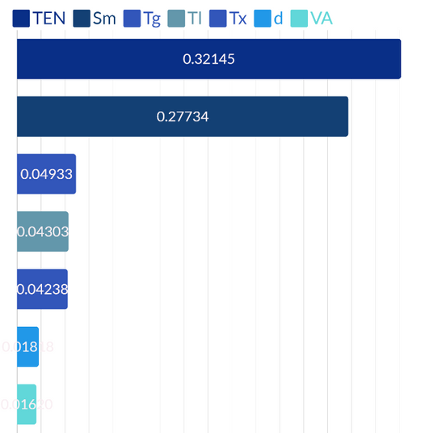
SHAP VALUES : explainable ai
SHAP Summary Plot
WHY SHAP?
SHAP analysis improves model explainability by revealing feature importance and the reasoning behind predictions.
It enhances understanding of feature rankings, fostering trust in machine learning models.
SHAP values help identify influential features, facilitating transparent decision-making.
Extra Trees Regressor model agrees with the SHAP value insight and also assigns maximum feature importance to Sm and TEN.
INSIGHTS FROM SHAP
TEN and Sm have the highest feature importance.
As this is a crystallization process, entropy may have a major role to play as it would control the transition from chaos to order.
The TEN value may be significant since it determines the strength of the bonds and subsequently, the packing factor. As a result, TEN is again a major factor in the crystallization process, and hence a very important feature .
Data Preprocessing
Data Visualisation
Base Model Selection
Final Stacked Ensemble Pipeline
SHAP Values
Inferences
Problem Statement
Data Landscape

Slide 10
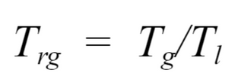
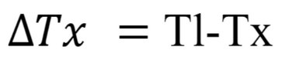
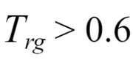
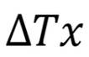
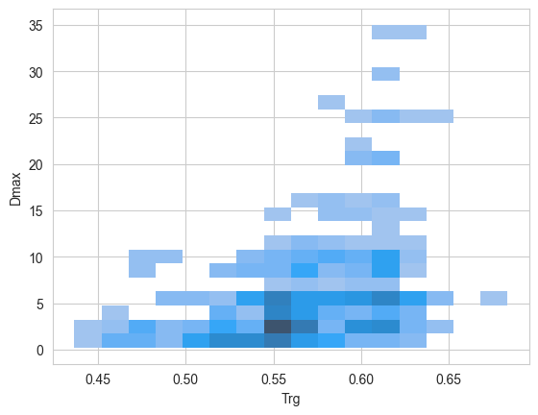
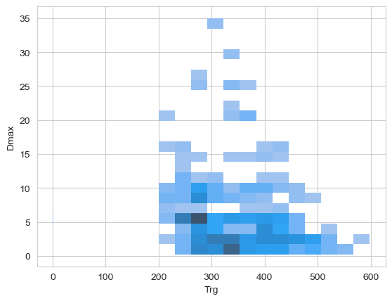
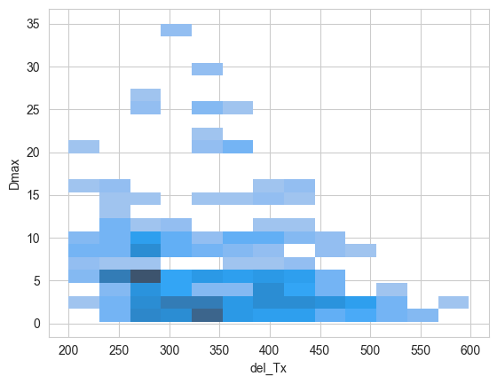
Inferences
, the alloy can be considered to have higher GFA
A larger indicates higher GFA.
Dmax vs Trg
Dmax vs del_Tx
reference: Critical evaluation of glass forming ability criteria C. Chattopadhyay , K. S. N. Satish Idury , J. Bhatt , K. Mondal and B. S. Murty
Data Preprocessing
Data Visualisation
Base Model Selection
Final Stacked Ensemble Pipeline
SHAP
Values
Inferences
Problem Statement
Data Landscape

Slide 11
Thank you

